Slide 1

Universities in busan
https://studyinbusan.com

Slide 2
Topics covered
Landing Page
Register Page
Login Page
Profile Page
University details Page
Register a University Page
Admin Dashboard Page
About us Page

Slide 3
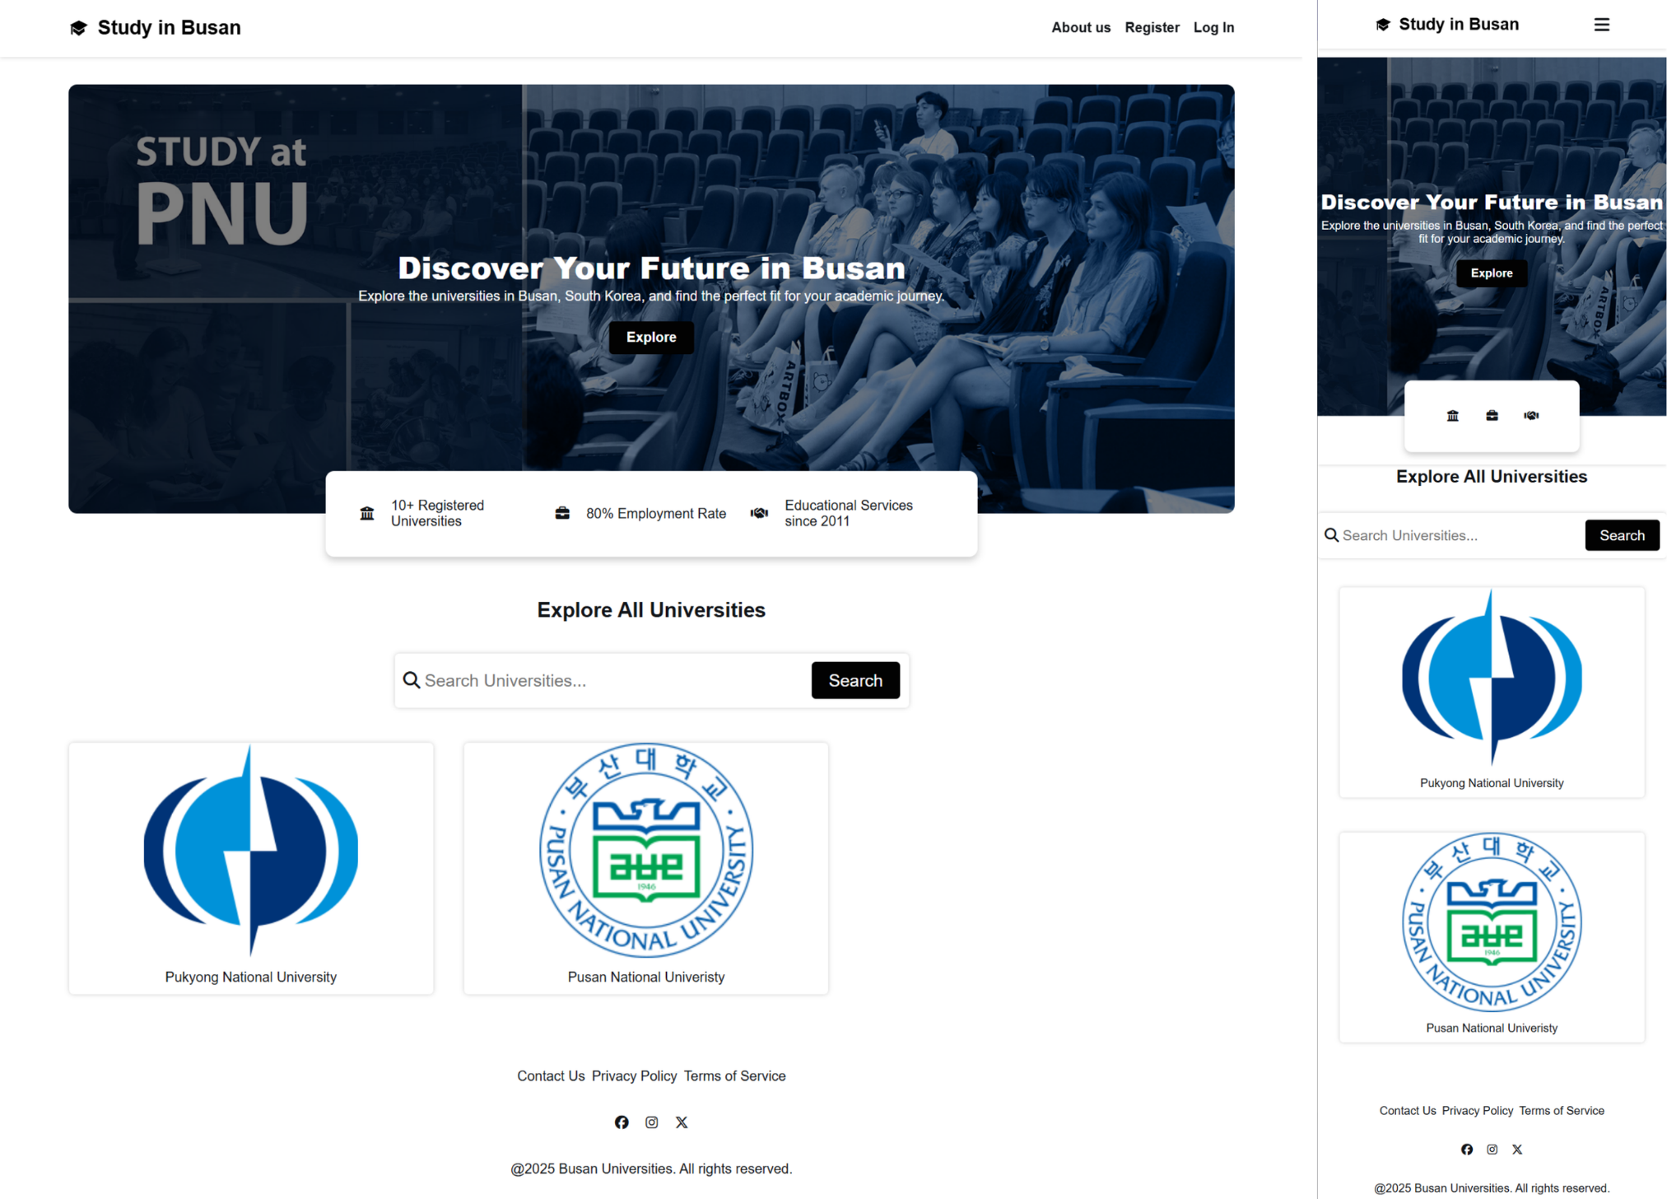
Landing page

Slide 4
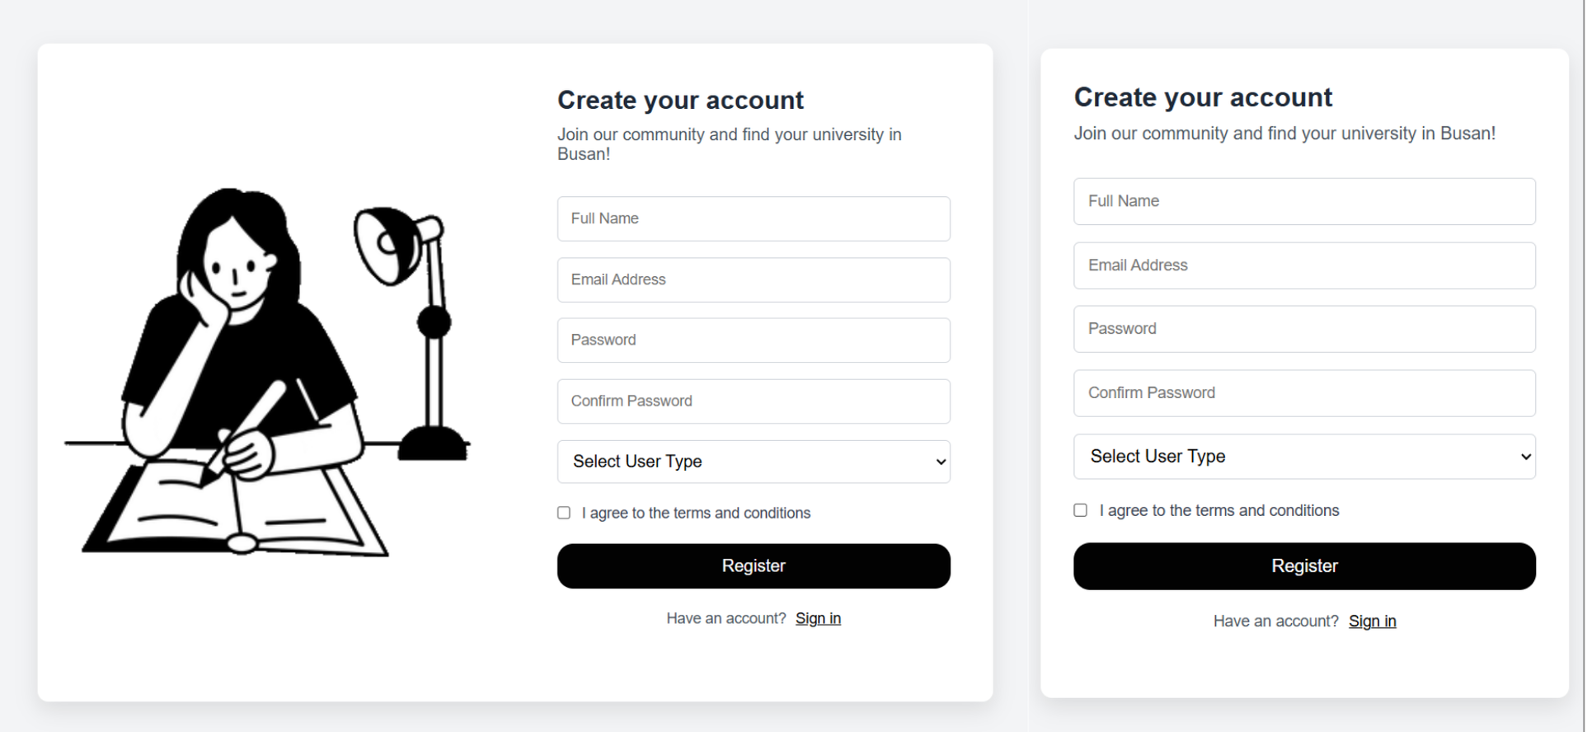

Register page

Slide 5
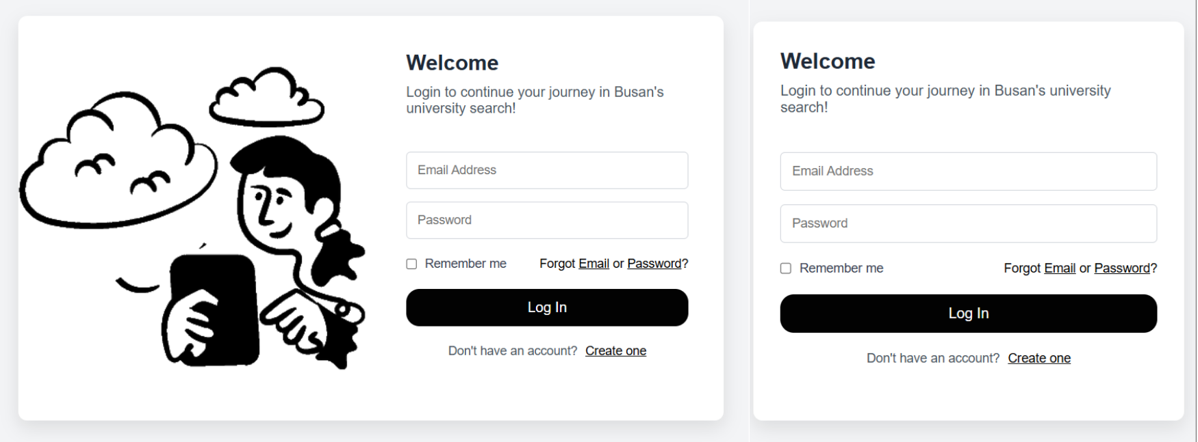

Login page

Slide 6
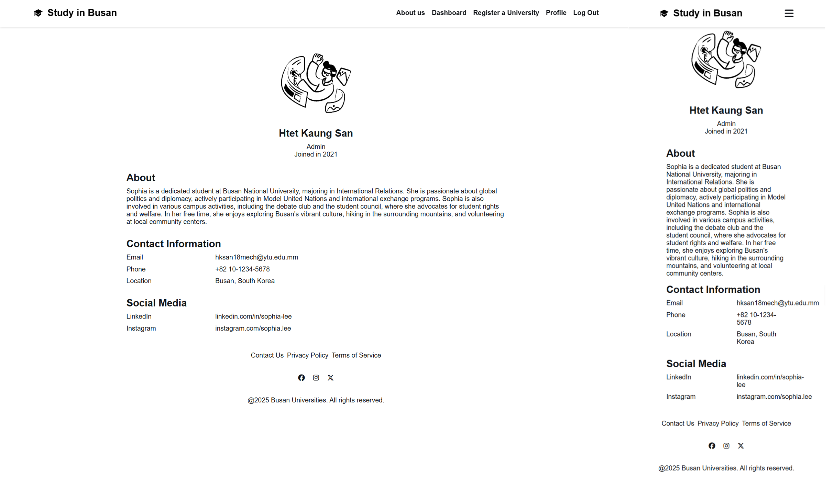

Profile

Slide 7
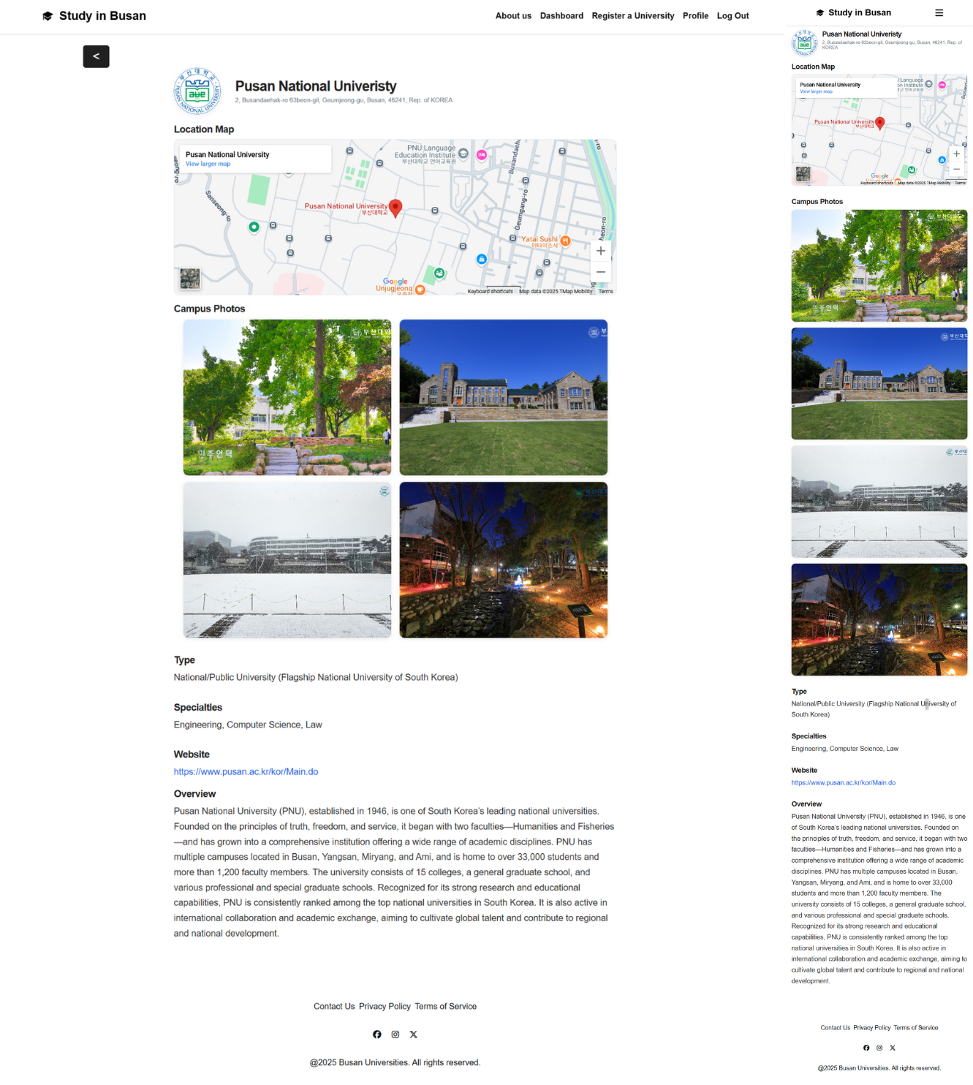
University details page

Slide 8
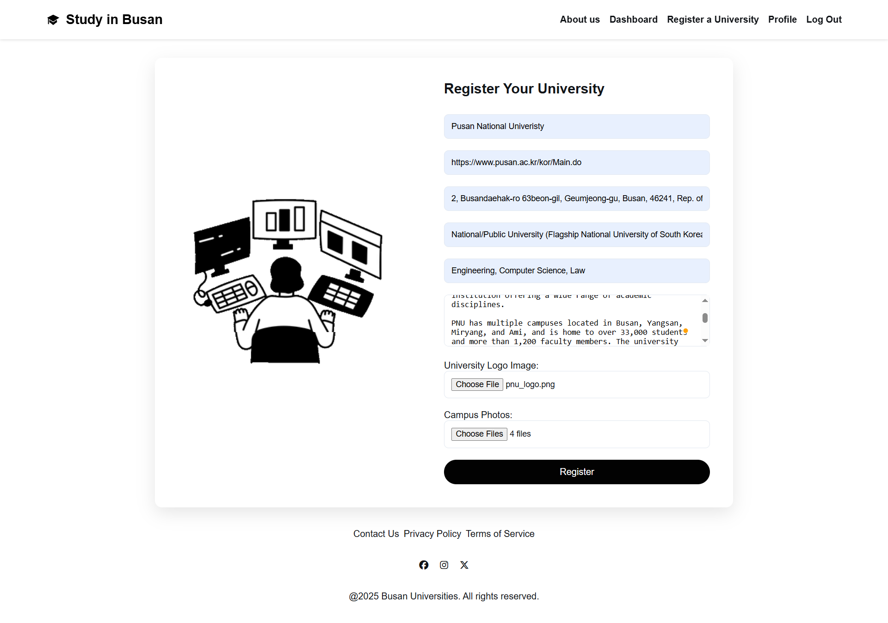
University registration page

Slide 9
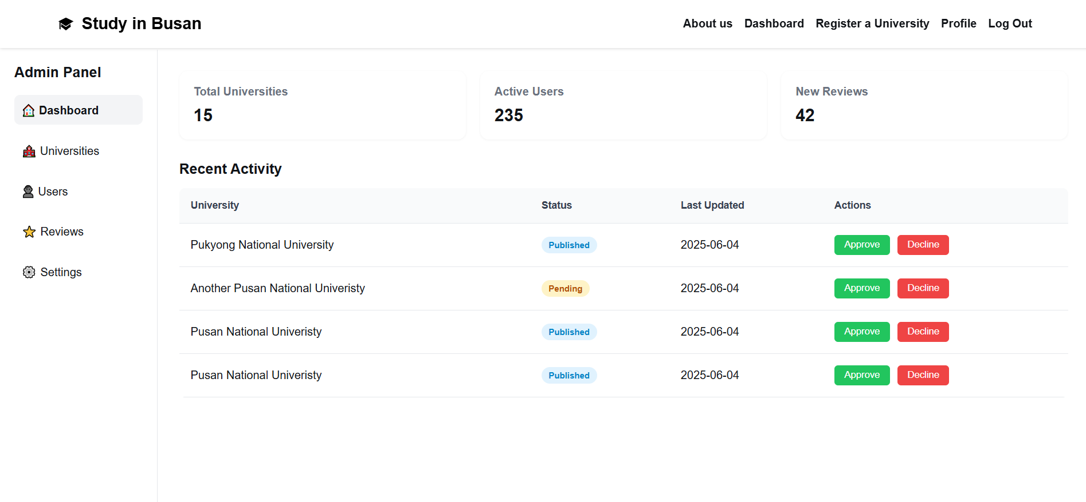
Admin dashboarD

Slide 10
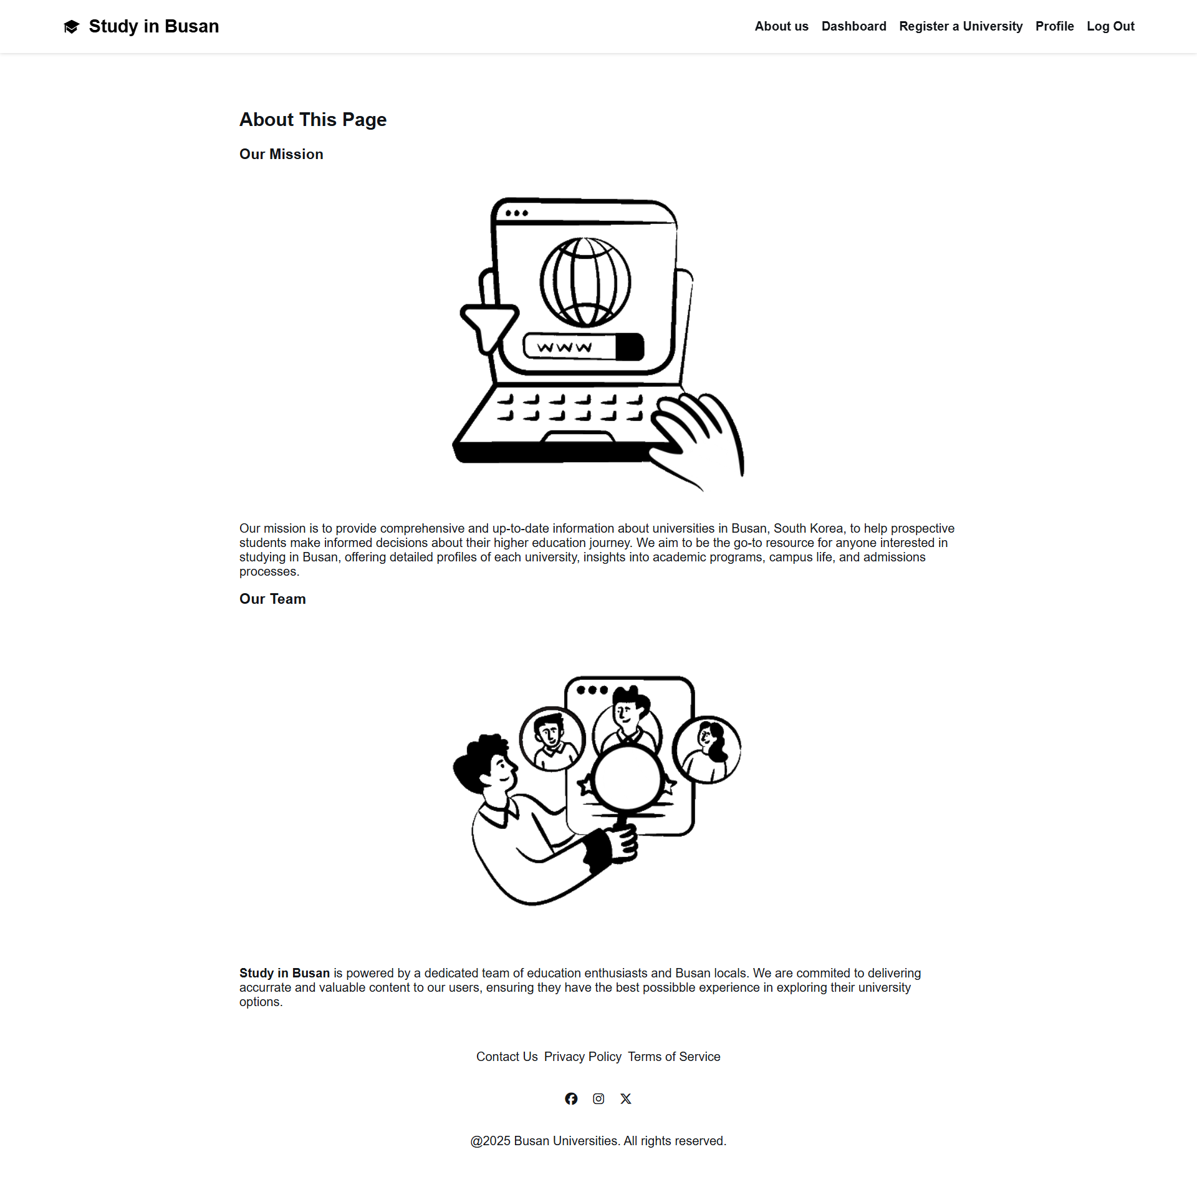
About us

